Slide 1
AceEngineer
Architecture Development
09 September 2018

Slide 2
Introduction
The object of establishing an architecture is to help standardize processes and thus scale for services
Our objectives is to have a consistent process for the key data objects
Programs or applications
Development
Repository
Deployment
Data storage
Databases for Dev, staging and production
Website
Development
Hosting
Regular files (Word, ppt, client data etc.)

Slide 3
Programs or Applications

Slide 4
Programs | Overview
Development will be done by multiple people. Therefore, to help team work, git is a great tool
Repository that supports git will be very beneficial
A CI/CD strategy will help deploy the applications in a continual manner with minimal or no interruption
Data insert into databases will be done by the programs

Slide 5
Code Repository
A comparison of available services is given below
 | AWS Codecommit | Azure Devops | GCP | BitBucket
No.of users | 5 | 5 | 5 | 5
No. of git requests | 10,000 | unlimited | ?
Per month | 50GB-month | unlimited | 50GB-month
Pipelines | 1 | 10?
Ranking
AWS seems to be the clear winner

Slide 6
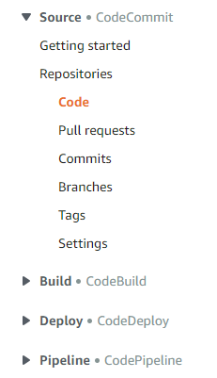
AWS | Life Cycle

Slide 7
Data Storage

Slide 8
Database - Production
A comparison of available services is given below
 | AWS DynamoDB | Azure | GCP BigQuery | BitBucket
Storage (GB) | 25 | 0?
Writes (MM/month) | 100
Reads (MM/month) | 100
Ranking
AWS seems to be the clear winner

Slide 9
Technology

Slide 10
Data Base
Database??
Mysql (or)
Amazon (or) Digital Ocean
Python Program
Data manager
Library
Sqlalchemy

Slide 11
Website or Apps

Slide 12
Apps - Production
A comparison of available services is given below
 | AWS | Azure App Service | GCP | BitBucket
No. of. apps | ? | 10
Ranking
Azure ranking high?

Slide 13
Website
Website Files??
Website Files
Local Computer
Development
Storage
Production
Online
(Amazon Litesale,
Digital Ocean,
Azure)
AceEngineer US Server

Slide 14
Recommended Technologies
Applications
Python Code
Website Building
Flask
GUI (or front design)
Angular JS
Database
Development and Stage on local computer
Technology: MongoDB or MySQL?

Slide 15
Regular File Storage

Slide 16
Overview
Completed project.
Amazon (S3 Storage)
To use long term.
Eg: KM-Riser Analysis Backup

Slide 17
Way Forward

Slide 18
References
https://aws.amazon.com/free/?awsf.Free%20Tier%20Types=categories%23alwaysfree
https://cloud.google.com/free/docs/gcp-free-tier
https://azure.microsoft.com/en-us/free/free-account-faq/

Slide 19
THANK YOU
For the opportunity to serve!

Slide 20
Document Revision History
01 | New document | 16 June 2016 |  | VA
Rev | Description | Date |  | Author | Checked | Approved
Document No: |  |  | Client Ref:
0132-PRE-0001-01 |  |  | n/a

